Slide 1
Devices of the Future
Michael Dempewolf
Assistant Professor of Computer Science
Clarke University
August 17, 2017

Slide 2

Agenda
Information Source
Mobile
Other Technology
Demonstration
Oculus
HoloLens
Drone

Slide 3
Information Source
Experts: Gartner – MIT
Patents
Tech Manufacturing
Moore’s Law
Market Trends
Notes:
The information presented here has been collected from various experts in the field ranging from Gartner to MIT. It is important to note that while much of the information presented here is guesswork, you will see many of the concepts enter into the market over the next 3 – 5 years. In some cases, the tech is already here or about to enter the market. There is no guarantee the industry will adopt of all of the concepts. However, this list would put together based on the most likely to be adopted based upon experts opinions. There are many items which did not make the list, but that does not mean they will not make it to market.

Slide 4
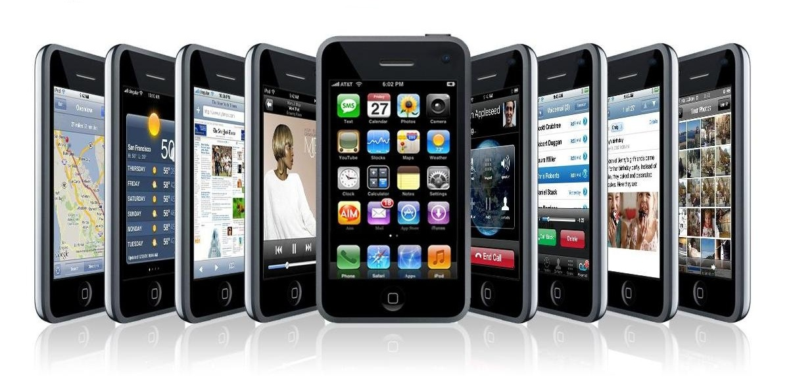
Mobile
Flexible
Wearable
Payments
5G Networks
Translation
Batteries
Notes:
Mobile is still king … and growing.
Cisco predicts there will be 11.6 billion connected devices by 2020 with over 5.5 billion users (70% world population)
More than half a billion (563 million) mobile devices were added in 2015 alone.
US mobile traffic alone will reach 2.9 exabytes per month by 2020. 2.9 exabytes = streaming 725 million DVDs each month.
With that in mind, we will take a closer look at the following mobile trends:
Flexible
Wearable
Payments
5G Networks
Translation
Batteries
References:
Source: http://government-2020.dupress.com/driver/mobile-technology/
http://www.hongkiat.com/blog/future-techonology-coming-true-soon/
http://mobilefuture.org/the-rise-of-mobile-11-6-billion-mobile-connected-devices-by-2020/

Slide 5
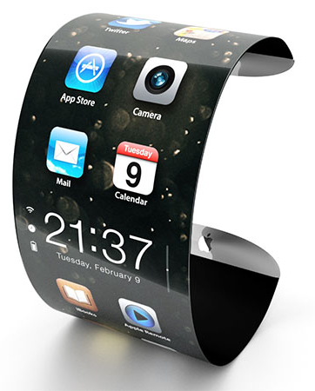
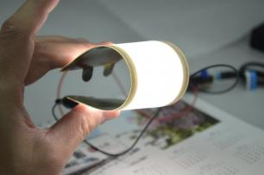
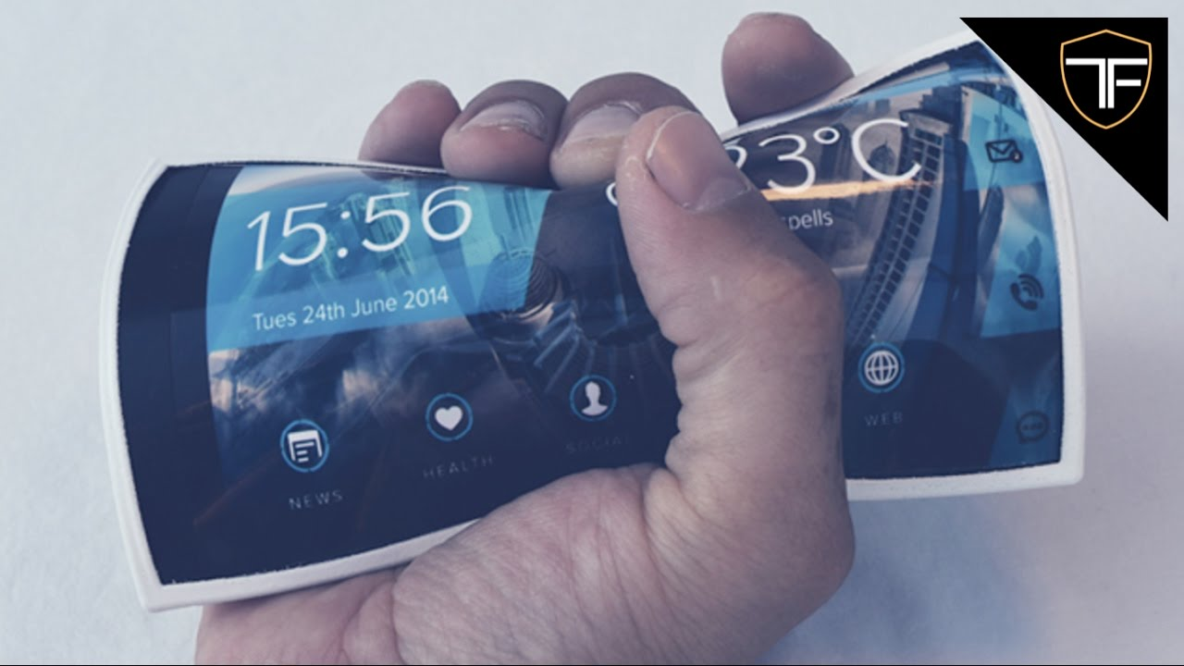
Mobile - Flexible
Notes:
Flexible mobile devices:
Using OLED technology. Provides flexible displays and lighting panels. OLED can be plastic, metal, or glass. The plastic and metal variants are incredibly bendable and virtually shatter proof.
First generation – manufacturers create displays which are curved.
Second generation – users will be able to bend the displays.
The technology will culminate in a display which can be bent, folded, or even stretched.
Sources:
https://www.oled-info.com/flexible-oled

Slide 6
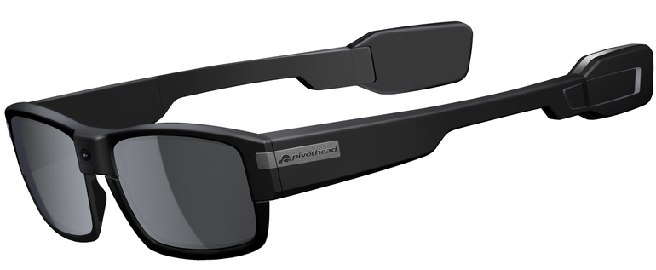
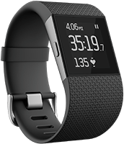
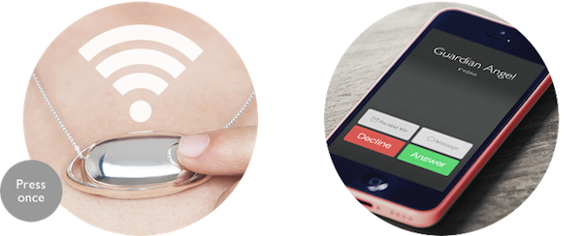
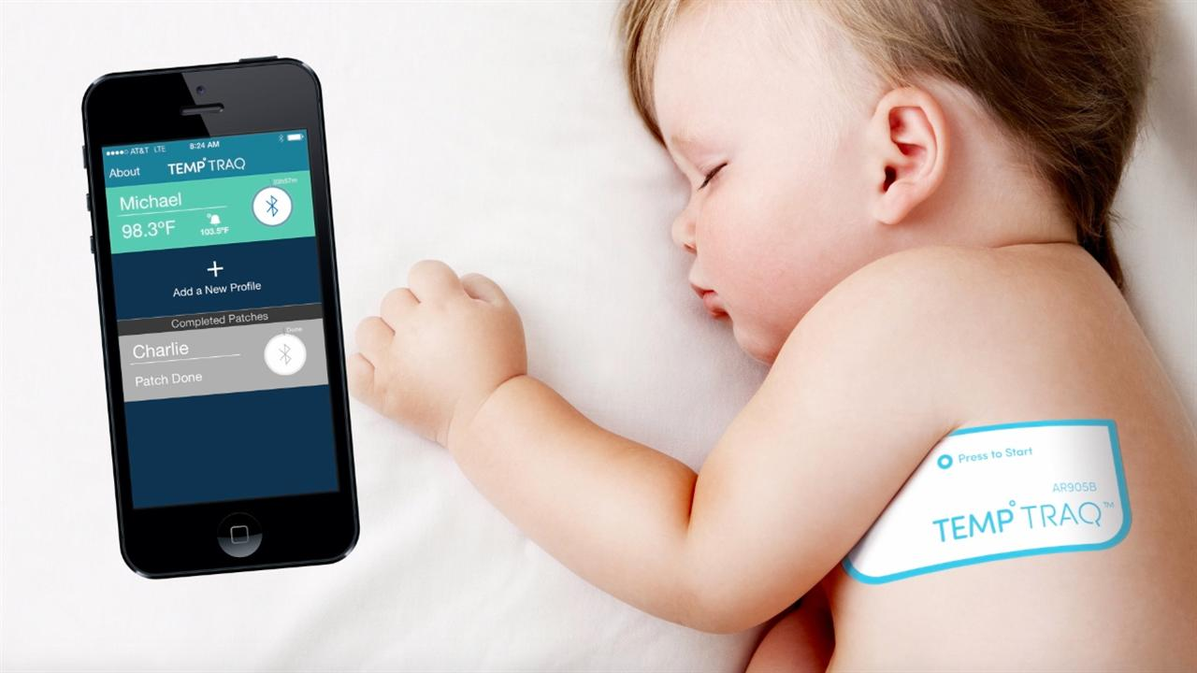
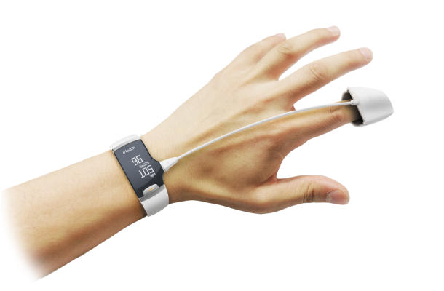
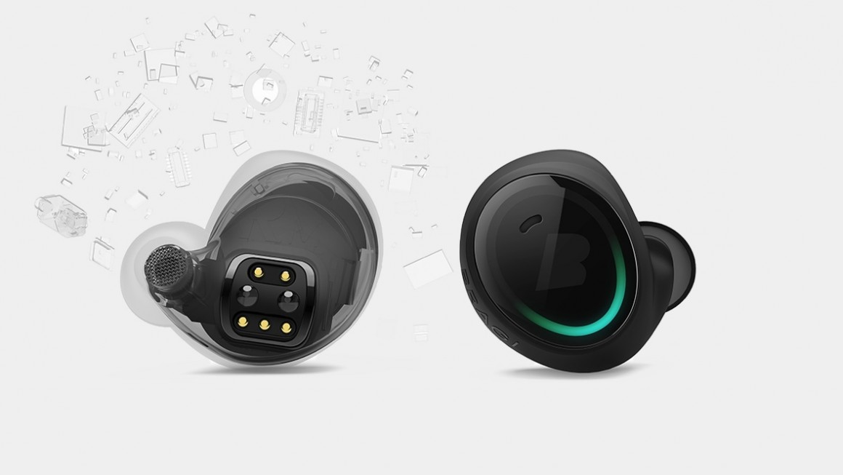
Mobile - Wearables
Notes:
Wearable technologies:
From smartphones to medical devices, wearable tech will transform the way we interact with technology.
Forbes predicts wearable tech market will be worth $34 billion by 2020
IDS predicts 323.6 million users will be using wearable tech by 2020
CSS Insights predicts the following:
Categories:
Wristband 164 million
Eyewear 97 million
Hearables 9 million
Wearable cameras 25 million
Watches 110 million
Tokens, Jewelry, and Clip ons 4 million
Other 2 million
Wearables will be used in numerous ways ranging from fitness to sports to fashion to augmentation to medical.
Cellular connection and innovations will ultimately free wearables from smartphones
Sources:
https://www.forbes.com/forbes/welcome/?toURL=https://www.forbes.com/sites/paullamkin/2016/02/17/wearable-tech-market-to-be-worth-34-billion-by-2020/&refURL=https://www.google.com/&referrer=https://www.google.com/
http://www.idc.com/getdoc.jsp?containerId=prUS41530816

Slide 7
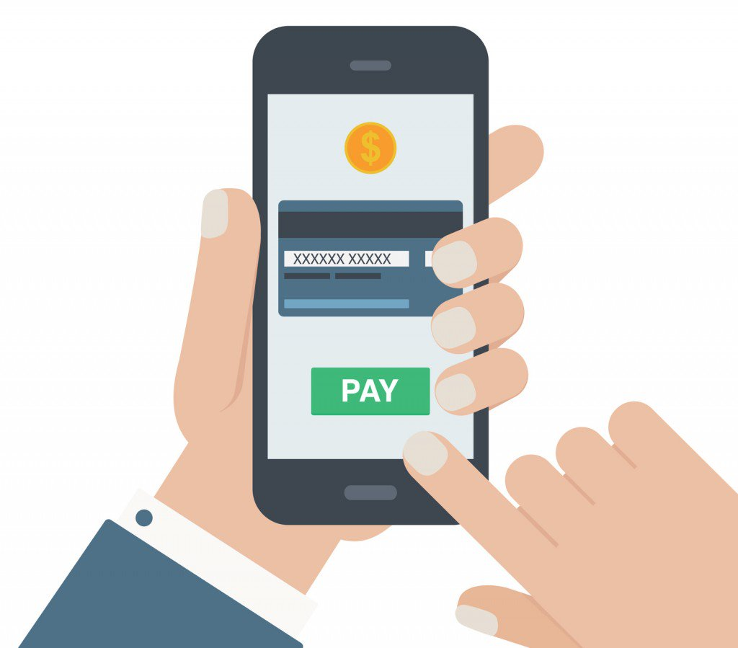
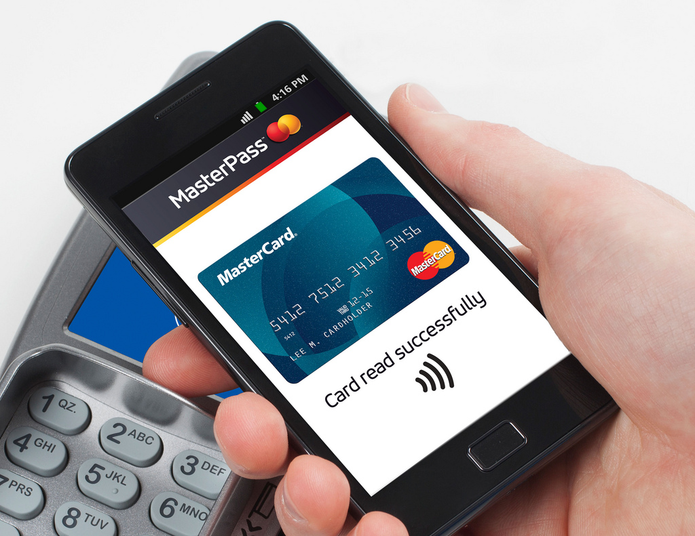
Mobile - Payments
Notes:
Many experts agree, mobile payments will become the standard by 2020.
PayBefore estimates the mobile payments will reach $410.5 billion by 2020
eMarketer noted just 19.4% of smartphone users currently use mobile payments. That number will rise to 33.1% by 2020.
Challenges:
Security concerns
Slow adoption rate of mobile payment by vendors
Disparity in mobile payments apps and vendor support
Sources:
http://paybefore.com/pay-news/study-mobile-payments-to-reach-410-5-billion-by-2020-as-m-wallets-flood-market/
https://www.emarketer.com/Article/Mobile-Payments-US-Growing-Fast-Still-Far-Mass-Adoption/1014689

Slide 8

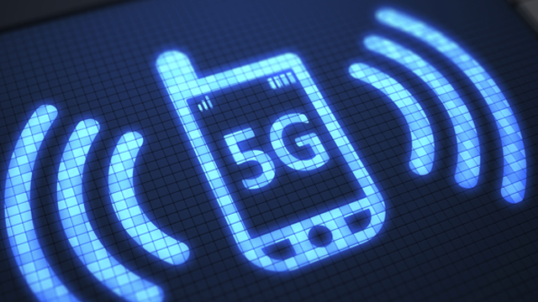
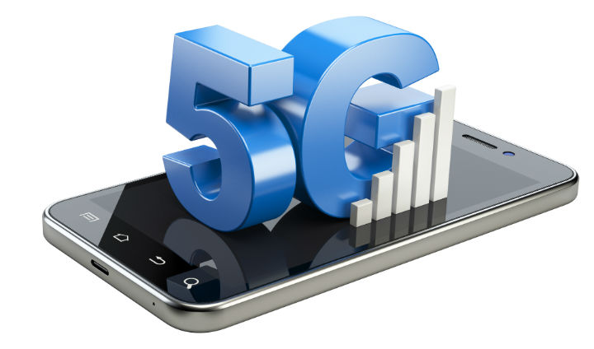
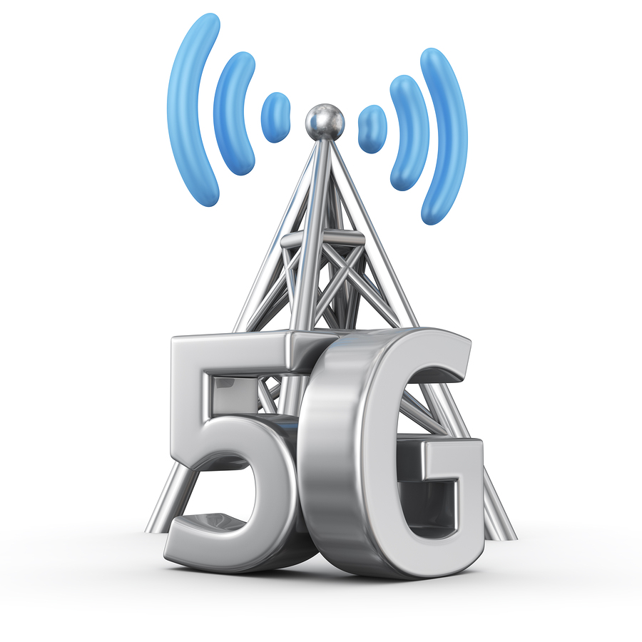
Mobile – 5g
Notes:
Most experts agree – 5G will be made available by 2020 (not everyone will have it right away). 5G modems are available now. Cellular carriers are gearing up now to make it ready.
The challenges:
No hardware standards, yet
5G will operate in what is known as the millimeter wave (30 GHz – 300 GHz)
Great for transferring large amounts of data
Require shorter distances -> more antennas, lots more antennas
More difficult to get around obstacles, walls, buildings
The benefits?
More speed, lots more speed! How much? It is hard to say at this stage as the standards are still being decided. Currently expected to be 100 times faster than 4G LTE
Examples:
Download the entire Lord of the Rings movies in seconds.
Live VR stream with little or no lag
Support many more devices -> IoT
Sources:
https://www.engadget.com/2017/05/02/t-mobile-plans-national-5g-network-by-2020/
https://www.pcmag.com/article/345387/what-is-5g
https://www.wired.com/2017/02/what-is-5g-and-when-do-i-get-it/
https://www.theregister.co.uk/2013/10/03/ntt_docomo_5g_google_glass_translation/

Slide 9


Mobile - Translation
Notes:
Voice and text translation will be available for the 2020 Tokyo Olympics. The translation will happen in real time without any delay. It will leverage the blazing fast speeds of 5G and the work of over a decades worth of translation work. The service will translate between English to Japanese and Japanese to English.
Glasses and touch screens (with the aid of token – such as a special ring) will allow users to view based upon their language choice.
Sources:
https://www.theregister.co.uk/2013/10/03/ntt_docomo_5g_google_glass_translation/
http://www.kwintessential.co.uk/blog/interpreting/japanese-automatic-voice-translation-to-impress-at-olympic-games-2020/

Slide 10
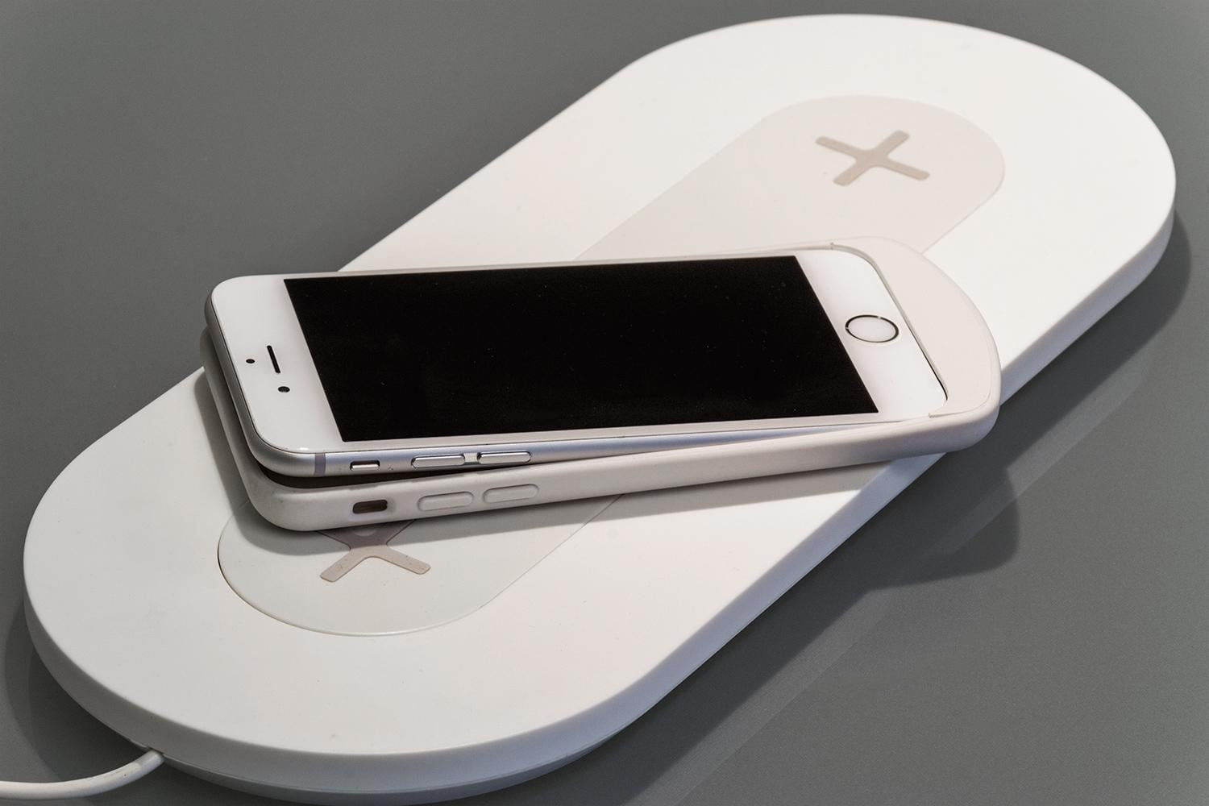
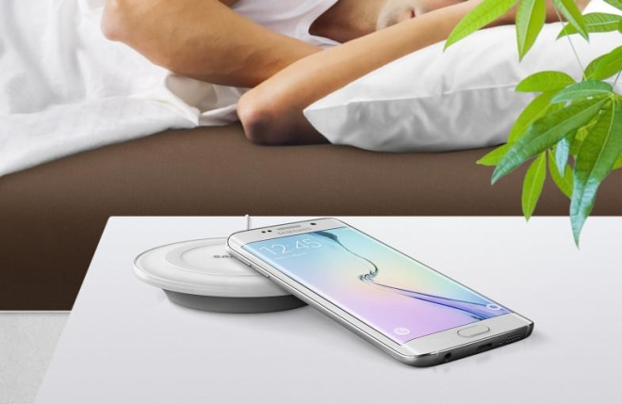
Mobile - Batteries
Notes:
Drexel University College of Engineering is working on a special material called Mxene capable of instantly recharging.
Charge time is in the tens of milliseconds
Toyota is working on a solid state battery which will be available in cars by 2020. A solid-state battery would be much smaller and lighter and it would have an improved life. This technology is also being researched for mobile phones.
Sony is building a battery with 40% higher energy density
Wireless charging:
Market and Market predicts wireless charging market will be worth $13.7 billion.
Mashable predicts the iPhone will remove its final hole and go wireless charging by 2020. They state it is not a question of if … but when. Given the fact Apple has already removed the headphone port, it is likely they will remove the lightning port sooner rather than later.
Slash Gear reports GM has signed an agreement with WiTricity which will provide the capability to wirelessly charge its electric batteries.
Juniper Research estimates nearly 40% of households will adopt wireless charging by 2020.
The challenges:
Multi vendors with non compatible technology operating in the field.
Large focus is automotive technologies
May not be compatible with instant (or reduced) charging technologies.
Sources:
https://thenextweb.com/tech/2017/07/28/scientists-are-creating-a-cell-phone-battery-that-charges-instantly/#.tnw_7lDoXrC3
https://techcrunch.com/2017/07/25/toyotas-new-solid-state-battery-could-make-its-way-to-cars-by-2020/
http://www.thedrive.com/news/6402/five-minute-recharging-batteries-coming-early-as-2020
http://gizmodo.com/sonys-building-a-battery-with-40-higher-energy-density-1748668432
http://www.marketsandmarkets.com/PressReleases/wireless-charging.asp
http://mashable.com/2017/06/30/iphone-future-no-ports/#AQCZcEf0APqs
https://www.slashgear.com/gm-witricity-wireless-car-charging-partnership-21468305/
https://www.juniperresearch.com/press/press-releases/mobile-wireless-charging-40pc-households-by-2020

Slide 11
Other devices/Tech
Drones
Internet of Things
Artificial Intelligence/Machine Learning
Automotive
Virtual/Augmented Reality
Notes:
Mobile is not the only area where we will see breakthroughs in technology. We will take a closer look at:
Drones
Internet of Things
Artificial Intelligence/Machine Learning
Automotive
Virtual/Augmented Reality

Slide 12
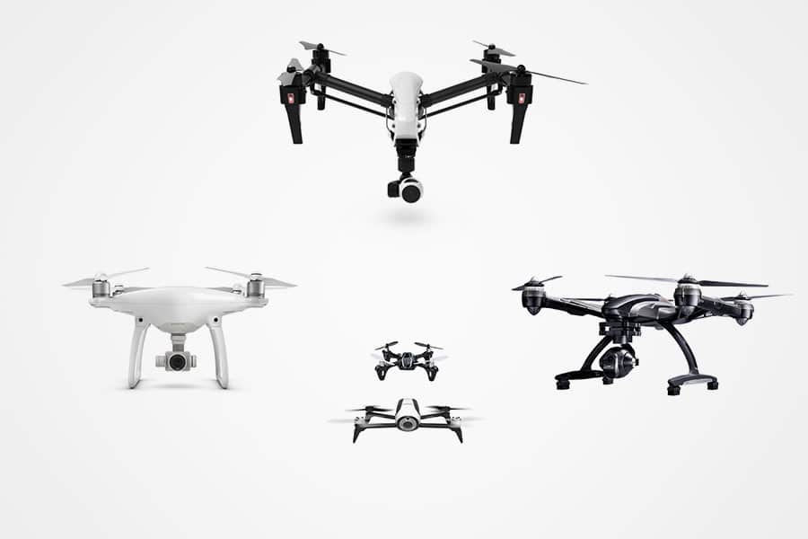
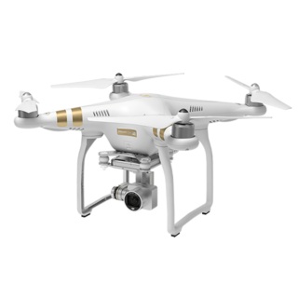
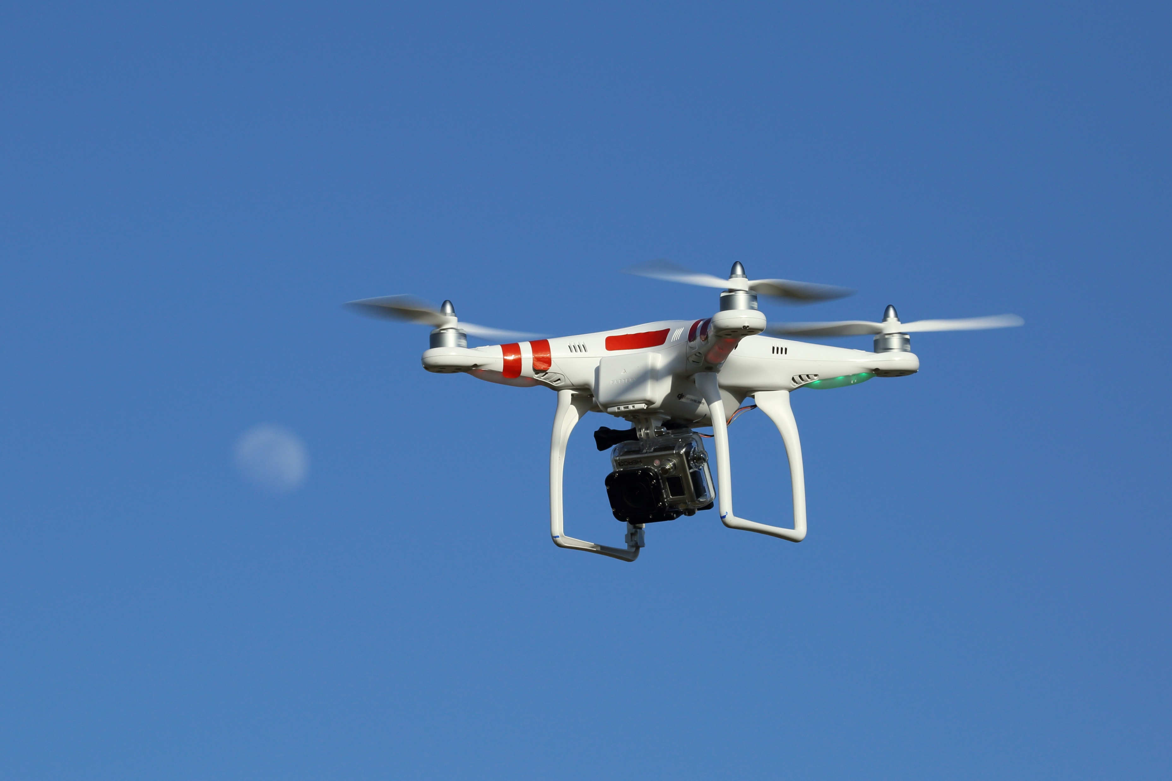
Drones
Notes:
FFA predicts there will be over 7 million drones flying over America by 2020.
Currently there are 2.5 million drones flying over America.
Uber plans on offering flying taxis using Vertical Take of and Landing (VTOL) drones in Dallas and Dubai by 2020.
Goldman Sachs notes drones have evolved from a strictly military application to a commercial application similar to GPS and the Internet.
Goldman Sachs notes drone technology will be a $70 billion industry by 2020. They note drones are already in use generating climate data, monitoring the borders and more.
Goldman Sachs notes drones will be able to support multiple fields:
Construction $11.1 billion
Agriculture $5.9 billion
Insurance Claims $1.4 billion
Offshore Oil/Gas Refining $1.1 billion
Police $885 million
Fire $881 million
Many others ranging from Coast Guard to Journalism to Border Patrol, Real Estate, Utilities, Pipelines, Mining, and Cinematography
Drones will be used in applications where it is too dangerous or too costly for humans/aircraft. Fire fighting water delivery targeting, inspections (pipes, electrical, etc).
Inspect crops in the field. Inspect 1,000 acres per day
Sources:
https://www.google.com/url?sa=t&rct=j&q=&esrc=s&source=web&cd=1&cad=rja&uact=8&ved=0ahUKEwiW6Nqvit3VAhXq44MKHd1PDfAQFggoMAA&url=http%3A%2F%2Fwww.popsci.com%2Fnew-faa-report-stares-in-face-drone-filled-future&usg=AFQjCNGy9LEhREf44hHOYTv8MeQHMtgCjg
http://www.dailymail.co.uk/sciencetech/article-4444874/Uber-looks-soar-flying-taxis-2020.html
http://www.goldmansachs.com/our-thinking/technology-driving-innovation/drones/

Slide 13
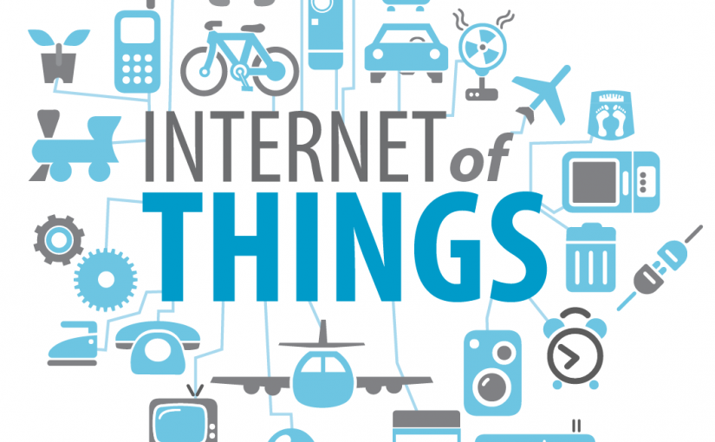
Internet of Things (IOT)
Notes:
Forbes predicts annual revenue from IoT will reach $470 billion by 2020. The number of devices will grow from 15.4 billion in 2015 to 30.7 billion in 2020.
IoT has the potential to impact the economy by $2.7 – $6.2 trillion until 2025.
Enterprises have been adopted IoT to improve their operations. Examples include:
Transportation/Fleet
Security and Surveillance
Inventory and warehouse management
Gartner says 8.4 billion devices will be connected in 2017. That number will rise to 20.4 billion by 2020.
Sources:
https://www.forbes.com/sites/louiscolumbus/2016/11/27/roundup-of-internet-of-things-forecasts-and-market-estimates-2016/#64795063292d
http://www.gartner.com/newsroom/id/3598917

Slide 14
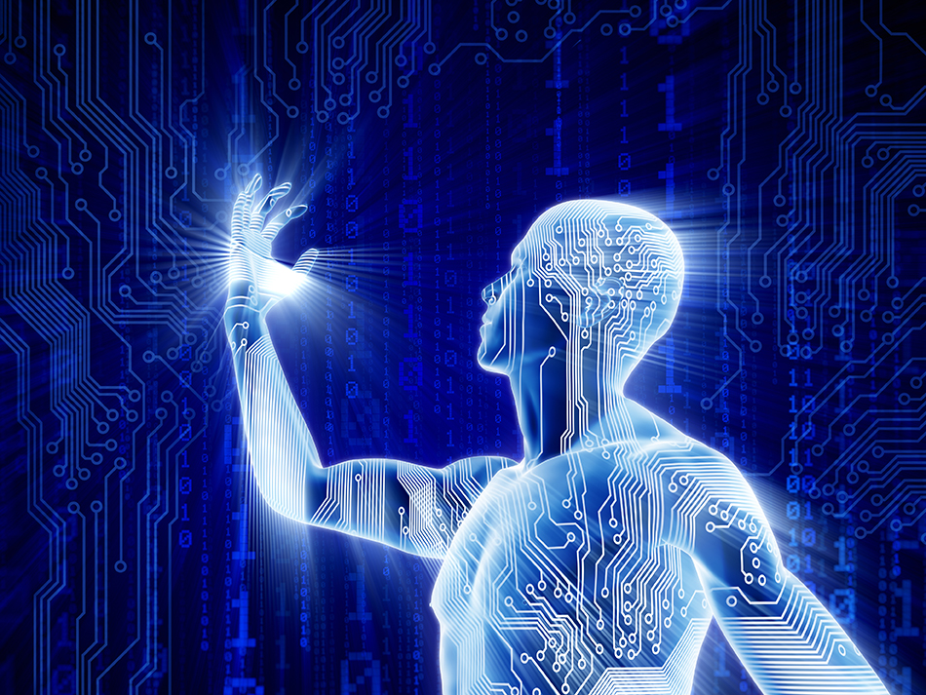

Artificial Intelligence/Machine Learning
Notes:
Gartner says AI will be in almost every new software product by 2020.
ZDNet stated cognitive and artificial intelligence systems will reach $12.5 billion by the end of 2017. That number will rise to $46 billion by 2020.
Already being used in services like Microsoft’s Cognitive Services which can analyze a photo and provide information about the photo: what is in the photo, emotions of humans in photos, describe actions in photos, etc.
Challenges:
Unsupervised learning – currently learn through a structured force-feeding. Some systems have already started the process. In some cases, the company has shut down the system as the machines learned in ways humans could not understand.
Creativity and abstract thinking – currently computers struggle in this area, but with deep thinking computers may be able to cross this threshold by 2020.
Public trust – Only 39% of the public trusts AI
Integration – AI needs to integrate with something practical.
General use – currently designed for specific tasks. Need to develop so AI can serve a general purpose. Currently being used in applications like Siri, Google Home, Amazon Alexa, Cortana
Sources:
http://government-2020.dupress.com/driver/artificial-intelligence/
https://www.forbes.com/sites/joemckendrick/2017/03/30/artificial-intelligence-will-make-its-mark-within-next-3-years/#2b52cf446d49
http://www.gartner.com/newsroom/id/3763265
http://www.zdnet.com/article/cognitive-and-artificial-intelligence-spending-expected-to-surge-through-2020-says-idc/

Slide 15
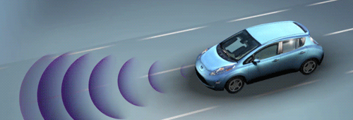
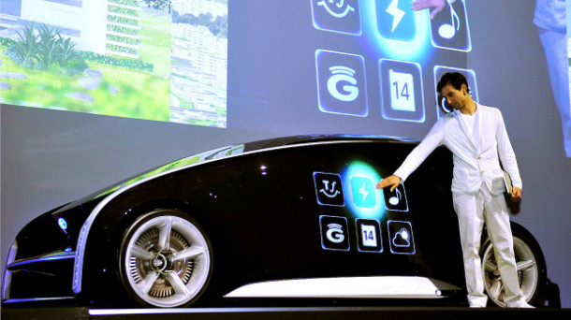
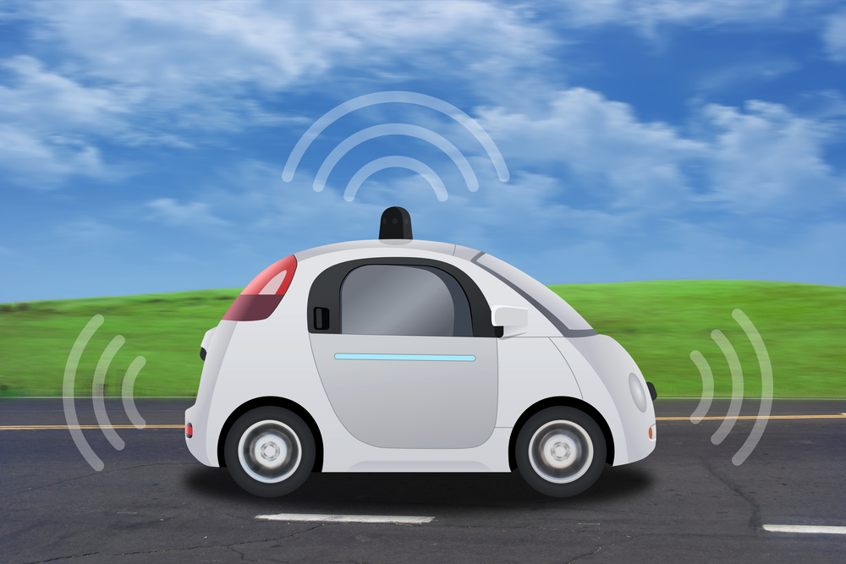
Automotive
Notes:
Forbes, TechCo, and Goliath all predict similar technologies by 2020 for the automotive industry. The list includes:
Autonomous vehicles – fully autonomous in certain area/under certain weather conditions
Driver override systems – take over for safety
Biometric vehicle access -
Comprehensive vehicle tracking – insurance companies will offer reduced rates to track your driving habits
Active window display – navigation, early warning, highlight low visibility obstacles
Remote vehicle shutdown – stop stolen cars in their tracks, ending police chases
Active health monitoring – ranging from monitor sleepy drivers to people with a heart attack (automatically pull over and call for help)
Four cylinder supercar – Currently have a V6 with over 600 horse power. By 2020, with lightweight composite material, we will have a supercar capable of over 200 mph with a 4 cylinder
Reconfigurable body parts – convert from truck to SUV
Smartphone integration
Car-to-car communication – alert one another to accidents, road blocks, or even bad weather
Sources:
https://www.forbes.com/sites/kbrauer/2015/01/19/top-10-advanced-car-technologies-by-2020/#46ee3ece6705
https://tech.co/top-10-advanced-car-technologies-2020-2015-09
http://www.goliath.com/auto/10-amazing-new-car-technologies-we-expect-by-2020/

Slide 16
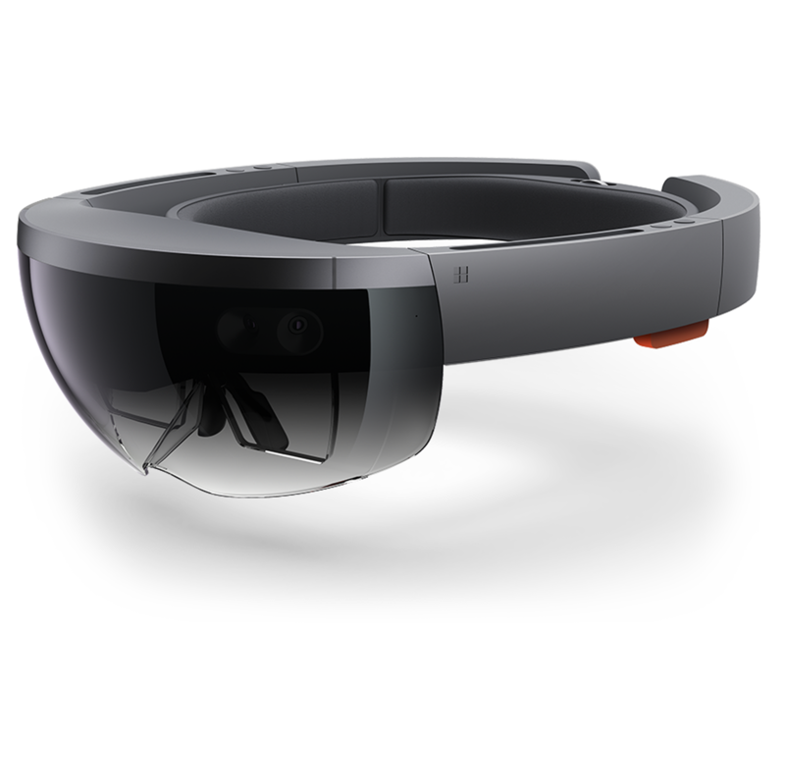
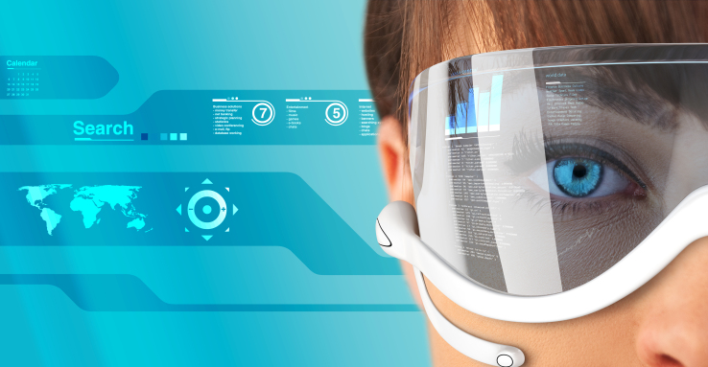
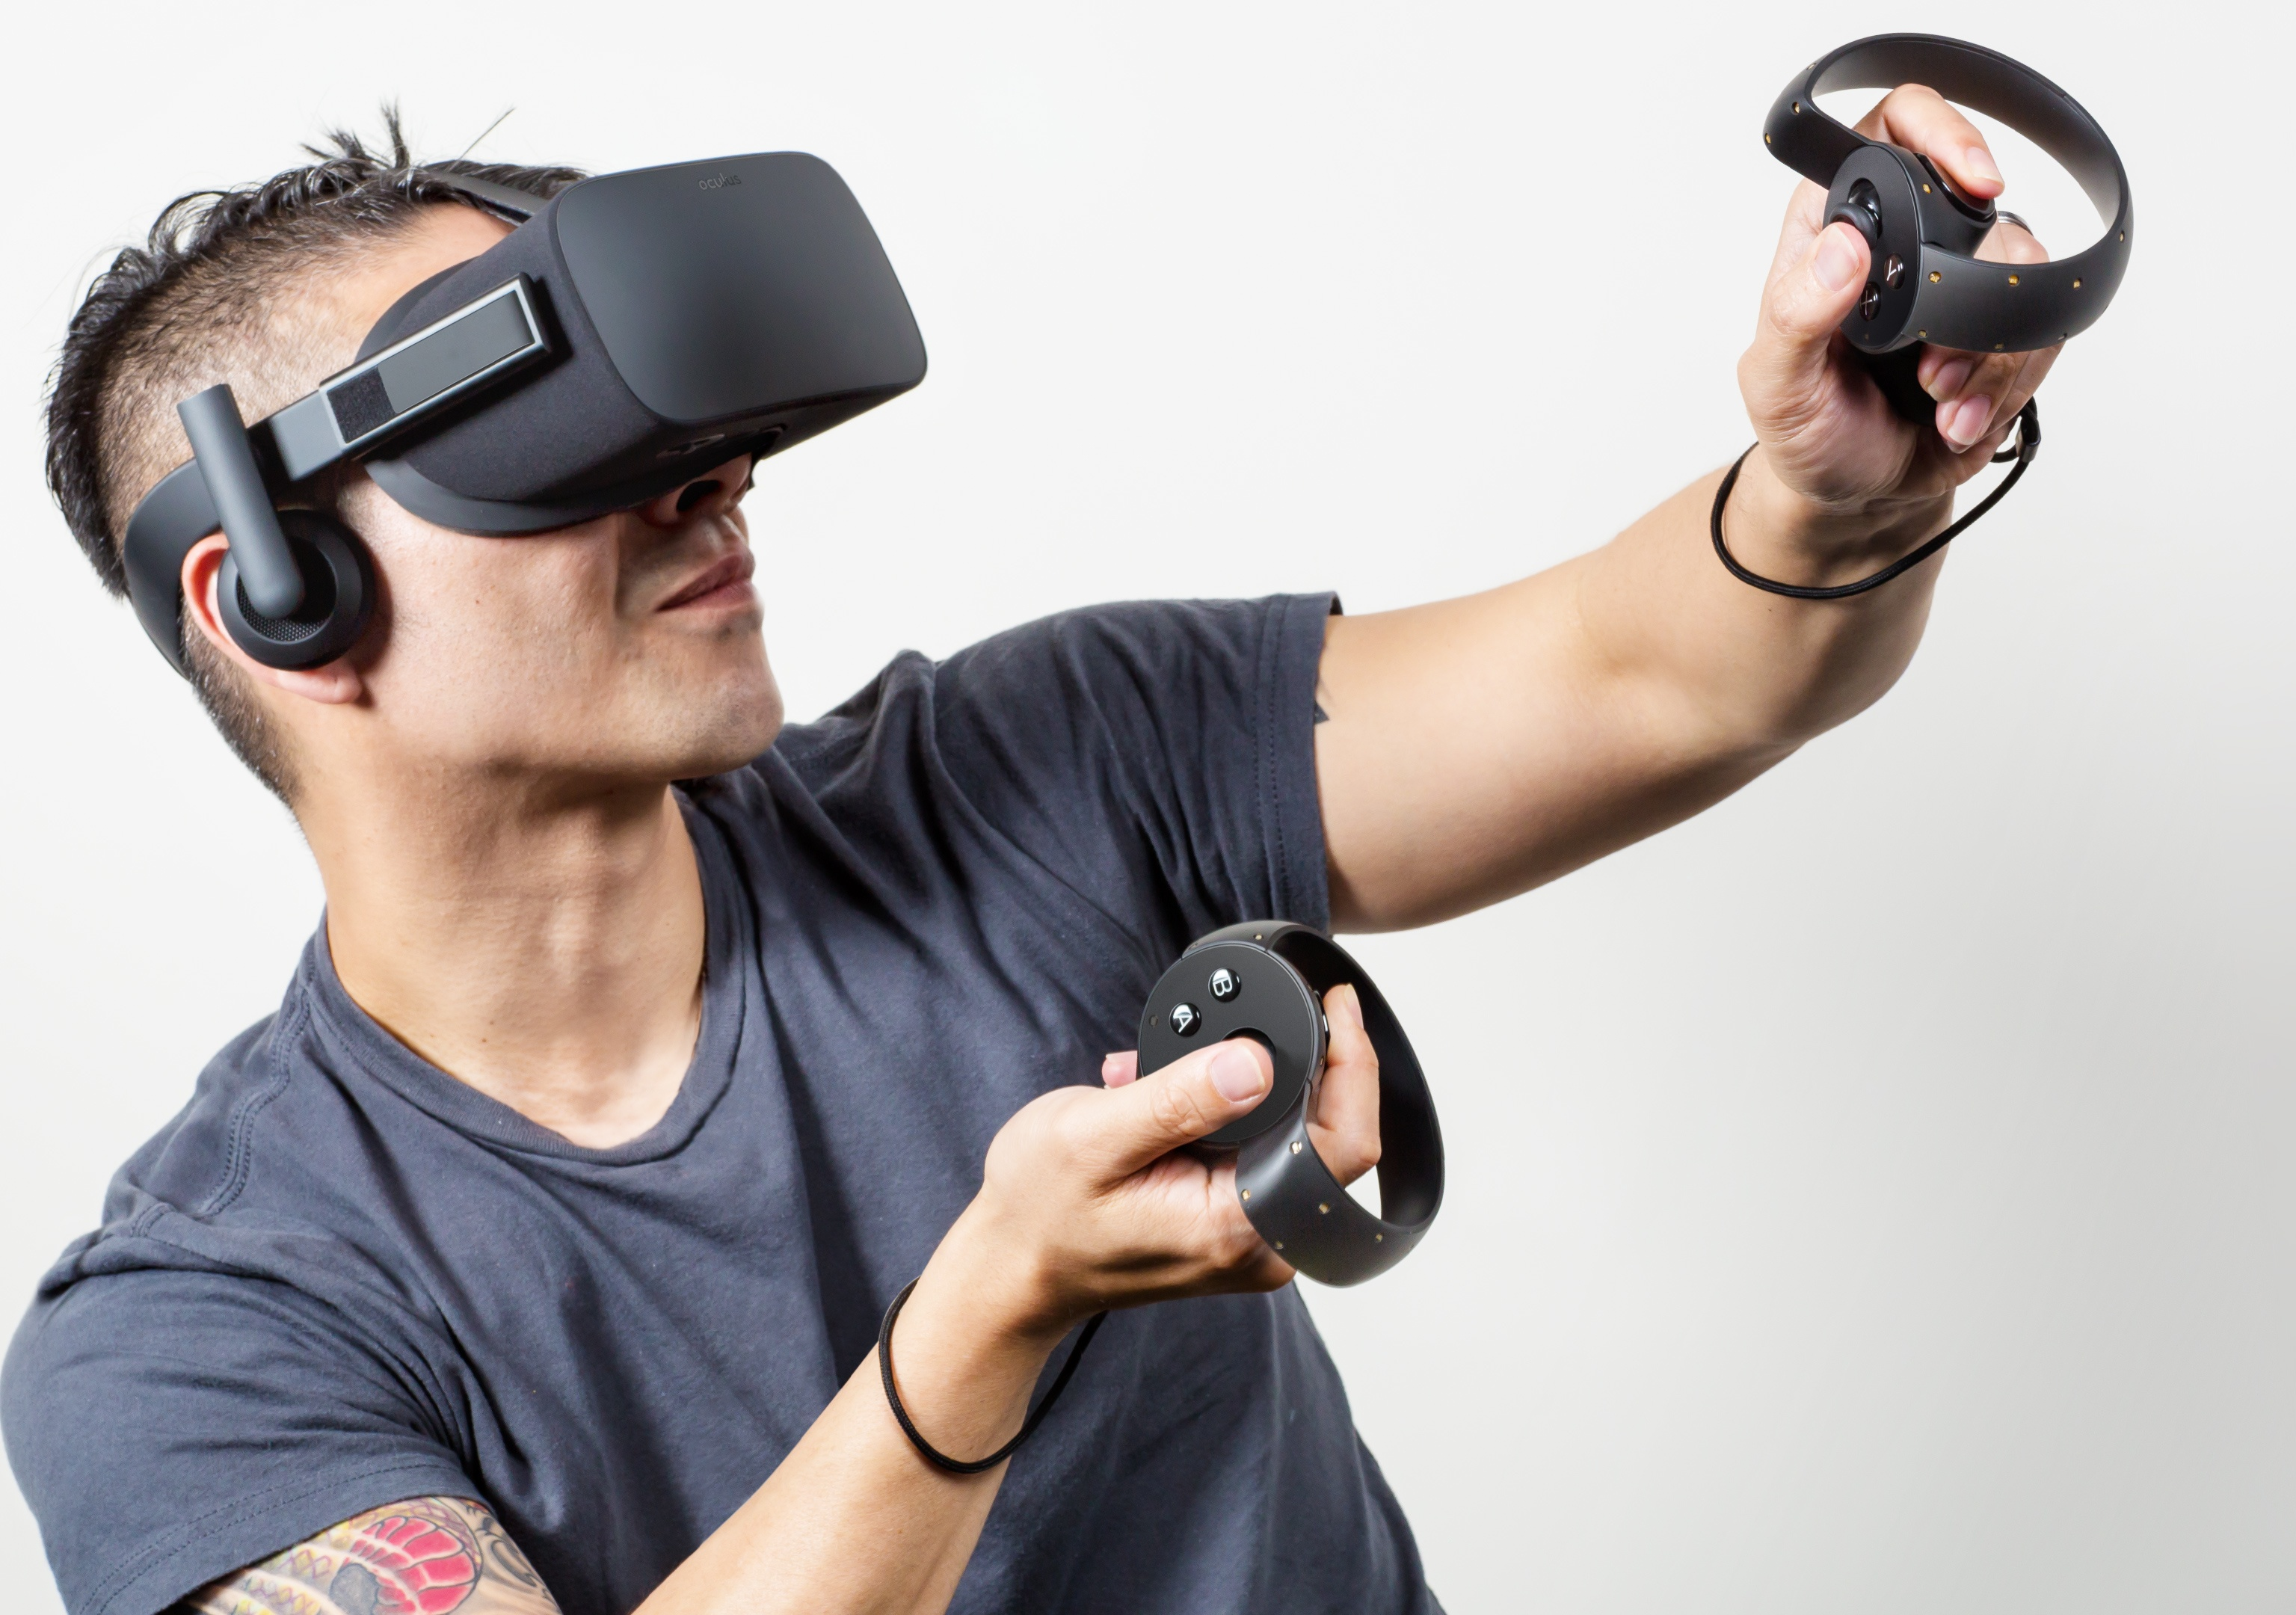
Virtual/Augmented Reality
Notes:
Gartner predicts by 2019 AR/VR/MR will be adopted by 20% of large-enterprises. Imaging going into Lowes to see your home improvements before you actually invest in them. Try different lights, materials, furniture and products while immersed in VR. Use AR in ware houses to increase efficiency in packing, reduce packing errors, and improve overall quality.
Fast Company predicts AR & VR will generate $150 billion in revenues by 2020. $120 million from AR and $30 million from VR.
Facebook purchased Oculus VR
Magic Leap has received over $592 million from investors like Google
Lensar - $131 million in funding
Nantmobile - $110 million in funding
JauntVR - $100 million in funding. Disney put in $65 million
Business Insider predicts VR & AR will reach $162 billion by 2020.
Sources:
http://www.businessinsider.com/virtual-and-augmented-reality-markets-will-reach-162-billion-by-2020-2016-8
https://www.fastcompany.com/3052209/vr-and-augmented-reality-will-soon-be-worth-150-billion-here-are-the-major-pla
http://www.gartner.com/smarterwithgartner/transform-business-outcomes-with-immersive-technology/

Slide 17
Bitcoin
$1000 computer = same processing power as human brain
Notes:
http://www.nbcnews.com/id/43015182/ns/technology_and_science-innovation/t/reasons-will-be-awesome-year/
http://government-2020.dupress.com/driver/mobile-technology/

Slide 18

Questions

